Slide 1

Software Architecture Frameworks
Software Architecture
3rd Year – Semester 1
Lecture 16

Slide 2
Why Software Architecture
Provides standard governing structure
Provide solutions to known problems
Helps to make projects successful
Addresses: Failing to consider key scenarios, failing to design for common problems, or failing to appreciate the long term consequences of key decisions can put your application at risk
Makes products easy to maintain
Notes:
Solution to known problems = Architecture Patterns (e.g. Client-Server, SOA, Layered Architecture, etc…)

Slide 3
When do we need to “Architect”
When the Solution(s) gets bigger
Modern Software are more complex than what was before
When you have to think about the future
Software lasts longer, they are no longer “throw-away” items - specially on Data
Increased Usage and Usage Types
Earlier only direct users interacted with Software, now Systems interact with each other

Slide 4
Enterprise Architecture
A well-defined practice for conducting enterprise analysis, design, planning, and implementation, using a holistic approach at all times, for the successful development and execution of strategy
Applies architecture principles and practices to guide organizations through the business, information, process, and technology changes necessary to execute their strategies

Slide 5
Benefits of Enterprise Architecture
Business Benefits
Helps an Organization achieve its business strategy
Faster time to market for new innovations and capabilities
More consistent business process and information across business units
More reliability and security, less risk
IT Benefits
Better traceability of IT costs
Lower IT costs – design, buy, operate, support, change
Faster design and development
Less complexity
Less IT risk

Slide 6
Key Architecture Principles
Build to change instead of building to last
Consider how the application may need to change over time to address new requirements and challenges
Build with flexibility to adopt changes
Model to analyze and reduce risk
Use design tools to visualize e.g. UML
Capture requirements and architectural and design decisions and to analyze their impact
Do not formalize the model to the extent that it suppresses the capability adapt easily
Communication and Collaboration
Use visualizations of the architecture to communicate and share your design efficiently with all the stakeholders, and to enable rapid communication of changes to the design
Identify key engineering decisions
Understand the key engineering decisions and the areas where mistakes are most often made
Invest in getting these key decisions right the first time (late changes are always costly)

Slide 7
Architecture Frameworks - How it evolved

Slide 8
Enterprise Architecture Frameworks
Zachman Framework
In 1982, when working for IBM and with BSP, John Zachman was perhaps the first to mention Enterprise Architecture in the public domain. In 1987, John Zachman, who was a marketing specialist at IBM, published the paper, A Framework for Information Systems Architecture. The paper provided a classification scheme for artifacts that describe the what, how, where, who, when and why of information systems.
The Open Group Architecture Framework (TOGAF)
In 1994, the Open Group selected TAFIM from the US DoD as a basis for development of The Open Group Architecture Framework (TOGAF), where architecture meant IT architecture.

Slide 9
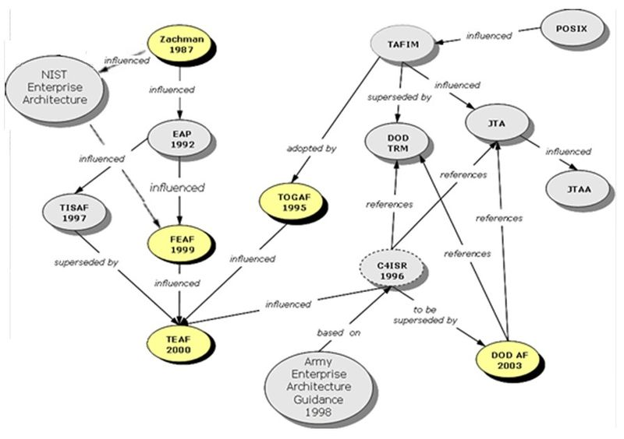
Architecture Frameworks – Mutual Influence

Slide 10
TOGAF
The Open Group Architecture Framework (TOGAF) is a framework for enterprise architecture that provides an approach for designing, planning, implementing, and governing an enterprise information technology architecture.
TOGAF is a high level approach to design. It is typically modeled at four levels: Business, Application, Data, and Technology.
TOGAF Relies heavily on modularization, standardization, and already existing proven technologies and products
TOGAF Components
Architecture Development Method (ADM)
Enterprise Continuum
Resource Base

Slide 11
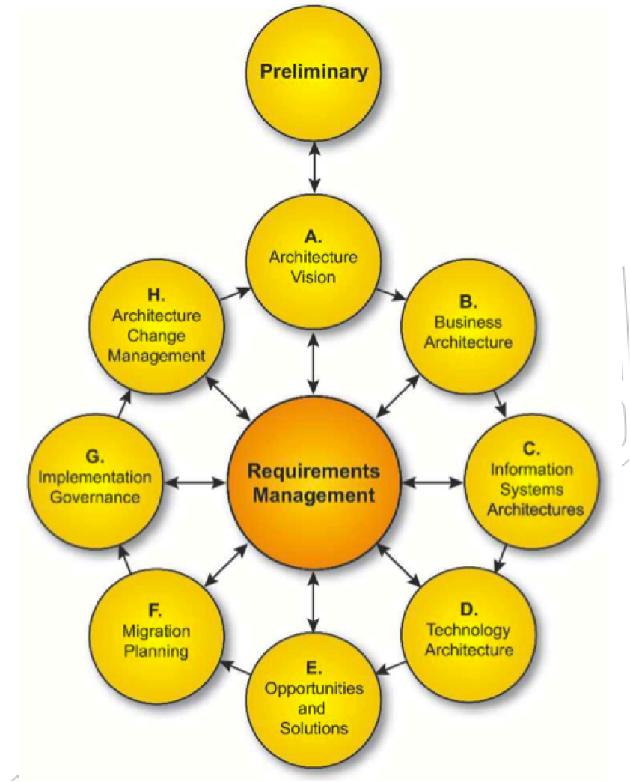
TOGAF – Architecture Development Method (ADM)
A Step by Step process to Developing or Changing an Architecture
Preliminary
Phase A
Phase B
Phase C
Phase D
Phase E
Phase F
Phase G
Phase H
Requirements Management
}
Defines the need for Architectural Change
}
Develops a Clear description of the Future Architecture
How the Vision & Future Architecture is Delivered
Implementation & Migrations Planning
Architectural Oversight to Implementation
Architecture Change Management

Slide 12
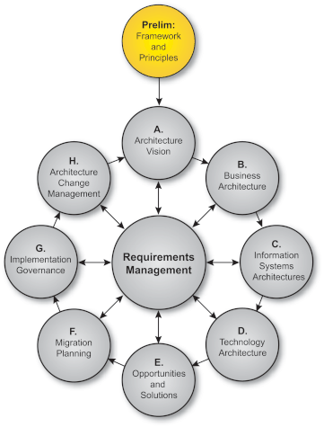
ADM – Preliminary Phase
Defines what needs to be done, how it will be carried out.
Establish parameters for a successful iteration of ADM
Identify and establish architecture Frameworks & Principles
TOGAF can be tailored to meet the needs
TOGAF can be integrated with other management frameworks (e.g. PRINCE2)
Output: Request for Architecture Work
Outlines Requirements, Organizational Context, Structures, Tools or Architecture Frameworks

Slide 13
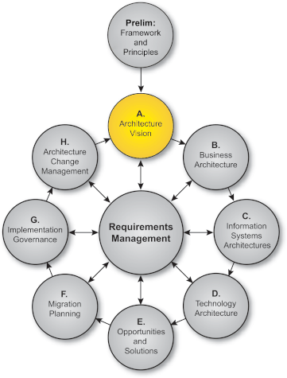
ADM – Phase A: Architecture Vision
Starts with Request for Architecture Work
Sells the benefits of the proposed capability to stakeholders and decision-makers
Outlines Vision for the Architecture
High-Level aspiration of capabilities
Business values that the Architecture will deliver
Identifies Concerns and Requirements.
Confirms business goals, drivers and constraints
Goal is to make sure that the enterprise is Able, Ready, Willing and Committed to make the necessary Architecture Changes
Output: Statement of Architecture Work
It also provides the Vision of the proposed enterprise architecture. This sense of direction is vital for guiding the work throughout this iteration of the ADM

Slide 14
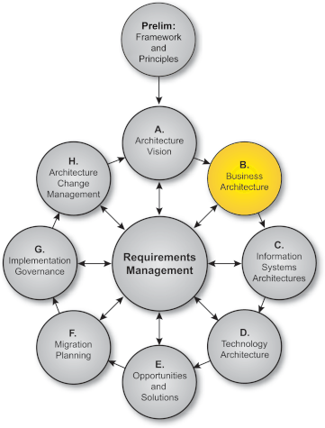
ADM – Phase B: Business Architecture
Starts with Improving Business Capability
Key objective is to identify Target Business Architecture that shows how the enterprise can achieve the Architecture Vision
Business Architecture demonstrate Business Value and Return on Investment (ROI) to the Stakeholders
Output:
Business models
Activity or Process models
Use Case

Slide 15
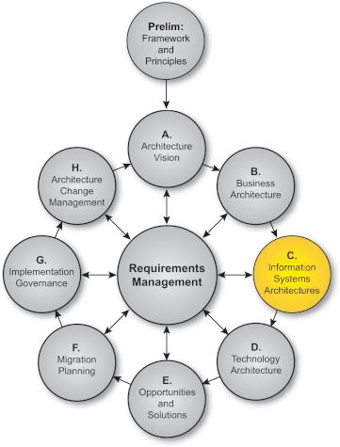
ADM – Phase C: Information Systems Architecture
Takes the Business Perspective from previous Phase as the input
Information Systems Architecture compose Data Architecture and Applications Architecture
Data & Application Architecture uses different reference models
Data Architecture – Class Diagrams, ER Diagrams
Application Architecture – Application Communication, Component Diagram, etc…
Identify Candidate Architecture Roadmap Components
Output:
Architecture Definition Document

Slide 16
Exercise #1
Business Case:
There are many types of Vehicles; Cars, Vans, Bikes, etc… Different types of vehicles may have specialized attributes but there are a few attributes in common.
A Person may own a vehicle for a given time and this ownership is registered at the Department of Motor Vehicles.
Q1) How would you develop Data Architecture for the Above? State your assumptions.
Q2) Draw the Data Architecture diagrams.

Slide 17
Exercise #1: Sample Answers…
Developing Data Architecture
Requirement Clarification meetings to be held to better understand the requirement. Use Case Diagrams to be created
A Gap Analysis on the requirement & business entities needs to be created.
Business and Logical Data Models to be identified. Create Diagrams i.e. Class Diagrams / Entity Relationship Diagrams to be created.
Assumptions
A vehicle cannot be a Car or a Van at the same time [Total Participation]
Vehicle will be owned by only 1 person at a given time [Person : Vehicle = 1 : M]
A vehicle ownership can be transferred from one person to another [Association Vs. Composition]
Vehicle & Person attributes can represented in Text, Number and Date formats
Diagrams
ER Diagram
Class Diagram
Table Structures

Slide 18
Exercise #2:
Business Case:
A CCTV Camera system captures a set of videos and send them to a central Server. The server needs to store the video and meta information for later retrieval.
Q1) Create the Data Architecture
Data Architecture diagrams.
Q2) Create the Application Architecture
Application Communication
Component Diagram

Slide 19
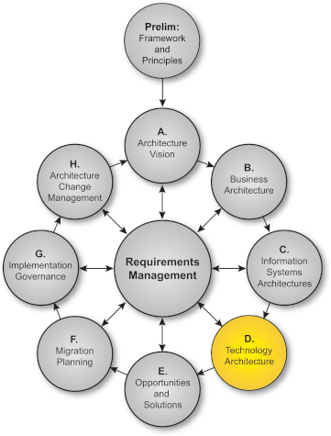
ADM – Phase D: Technology Architecture
Technology Architecture is a description of…
Structure and interaction of the platform services
Logical and Physical technology components.
Develop Baseline Technology Architecture
Creates Technology Reference Models & Criteria for Measurement
Develop Target Technology Architecture - requirements traceability, criteria for selection of service portfolio
Output:
Baseline Technology Architecture
Networked Computing/Hardware view
Communications view
Processing view
Technology Architecture Report (summarizing the key findings)

Slide 20
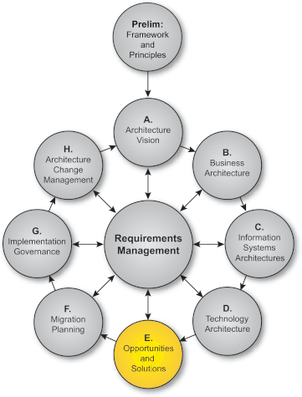
ADM – Phase E: Opportunities and Solutions
About finding Opportunities for…
Delivering the Target Architecture by implementing specific Solutions.
Concentrated on How to Deliver the Architecture
When the change is large, this Phase provides an Incremental Approach to convert from Baseline to Target Architecture
Generates the first complete version of Architecture Roadmap by combining the analysis and suggestions from the Architecture Development phases
Output:
High-level Implementation Plan
High-level Migration Plan & Impact Analysis

Slide 21
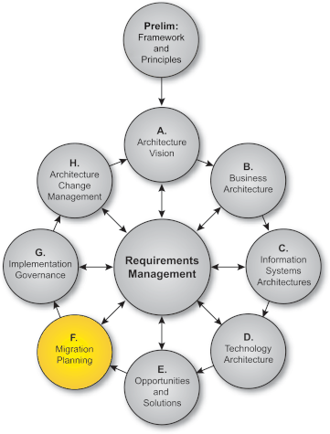
ADM – Phase F: Migration Plan
Finalizes a detailed Implementation and Migration Plan
Also finalizes the Architecture Roadmap
Plan is coordinated with…
Change management approach used within the enterprise
Business Planning
Enterprise Architecture
Portfolio and Project Management
Operations Management
Goal is to ensures that key stakeholders fully understand
Business value
Cost of work packages
Transition and Future Architectures

Slide 22
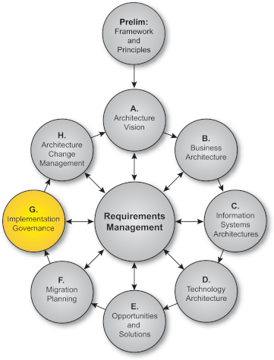
ADM – Phase G: Implementation Governance
Provides an Architectural Oversight to Implementation
Ensures Project Implementation conforms the Target Architecture
Formulate Project Recommendations
Manages Implementation Driven Architecture Changes
Review Ongoing Implementation Governance and Architecture Compliance
Confirms the scope and priorities for deployment
Guiding development and solutions deployment
Performs compliance reviews
Output:
Architecture Contract Document (drives any Architecture Changes)

Slide 23
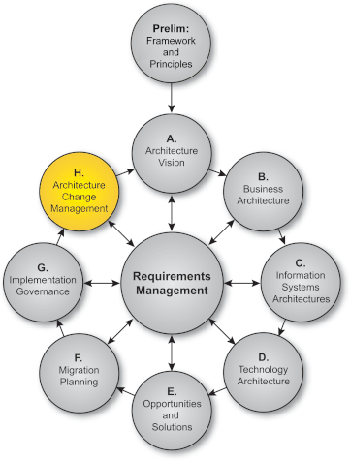
ADM – Phase H: Architecture Change Management
Change management process to manage changes to the Architecture
Process for managing changes
Ensure Architecture achieves its intended Business Value
Requires continues monitoring
Governance Requests
New Technologies
Changes in the Business Environment
Strategic Changes (e.g. Cost)
Judge whether a Change Request warrants a simple architecture update or whether it requires to Re-Architect with ADM
Output:
Architecture updates
Changes to architecture framework and principles
New Request for Architecture Work

Slide 24
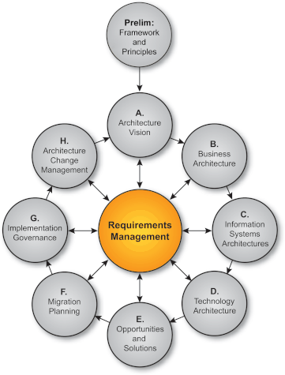
ADM – Requirement Management
It’s a Continuing Ongoing Process and sits in the center of the ADM
Requirements are Produced, Analyzed and Reviewed in each ADM Phase
Ensured Changes to Requirement are well governed and Reflected in all other Phases
Describes a Process for Requirements Management and how they are lined to the other Phases
Output:
Changed requirements
Requirements Impact Statement

Slide 25
Zachman Framework
Zachman Framework is an enterprise ontology and is a fundamental structure for Enterprise Architecture which provides a formal and structured way of viewing and defining an enterprise.
The ontology is a two dimensional classification schema that reflects the intersection between two historical classifications.
Dimension #1: What, How, Where, Who, When and Why
Dimension #2: Contextual, Conceptual, Logical, Physical, As Built and Functioning Enterprise
Notes:
This ontology can be used for Completely Describe anything in the Software System

Slide 26
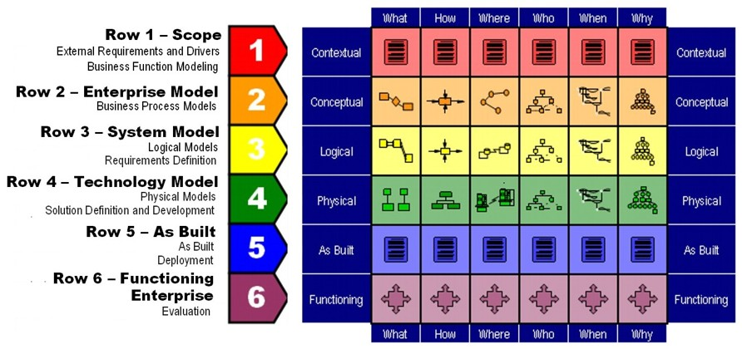
Zachman Framework – Rows
Notes:
These 36 categories can be deliverables: For each stakeholder/role/perspective for each stage

Slide 27
Zachman – Row 1: Scope (Planner’s View)
Motivation/Why
Business goals, objectives and performance measures
Function/How
High-level business functions
Data/What
High-level data classes related to each function
People/Who
Stakeholders related to each function
Network/Where
Locations related to each function
Time/When
Cycles and events related to each function
What
How
Where
Who
When
Why
1
Contextual
Contextual
Conceptual
Conceptual
Logical
Logical
Physical
Physical
As Built
As Built
Functioning
Functioning
What
How
Where
Who
When
Why
Notes:
Scope is about:
External Requirements and Drivers
Business Function Modeling

Slide 28
Zachman – Row 2: Enterprise Model (Designer’s View)
Motivation/Why
Policies, procedures and standards for each process
Function/How
Business processes
Data/What
Business data
People/Who
Roles and responsibilities in each process
Network/Where
Locations related to each process
Time/When
Events for each process
Sequencing of integration
Process improvements
What
How
Where
Who
When
Why
Contextual
Contextual
2
Conceptual
Conceptual
Logical
Logical
Physical
Physical
As Built
As Built
Functioning
Functioning
What
How
Where
Who
When
Why
Notes:
Enterprise Model is about:
Business Process Models
Business Function Allocation
Elimination of Function Overlap and Ambiguity

Slide 29
Zachman – Row 3: System Model (Designer’s View)
Motivation/Why
Policies, standards and procedures associated with a business rule model
Function/How
Logical representation of information systems and their relationships
Data/What
Logical data models of data
Data relationships
People/Who
Logical representation of access privileges
Network/Where
Logical representation of the distributed architecture
Time/When
Logical events and their triggered responses
What
How
Where
Who
When
Why
Contextual
Contextual
Conceptual
Conceptual
3
Logical
Logical
Physical
Physical
As Built
As Built
Functioning
Functioning
What
How
Where
Who
When
Why
Notes:
System Model is about;
Logical Models
Project Management
Requirements Definition

Slide 30
Zachman – Row 4: Technology Model (Builder’s View)
Motivation/Why
Business rules constrained by information systems standards
Function/How
Specifications of applications that operate on particular technology platforms
Data/What
Database management system
Logical data models
People/Who
Access privileges to technologies
Network/Where
Network devices and their relationships
Time/When
Specification of triggers to respond to system
What
How
Where
Who
When
Why
Contextual
Contextual
Conceptual
Conceptual
Logical
Logical
4
Physical
Physical
As Built
As Built
Functioning
Functioning
What
How
Where
Who
When
Why
Notes:
Technology Model is about;
Physical Models
Technology Management
Solution Definition and Development

Slide 31
Zachman – Row 5: As Built (Integrator’s View)
Motivation/Why
Business rules constrained by specific technology standards
Function/How
Programs coded to operate on specific technology platforms
Data/What
Data definitions by physical data models
People/Who
Access privileges to control access
Network/Where
Devices configured to conform to node specifications
Time/When
Timing definitions coded to sequence activities
What
How
Where
Who
When
Why
Contextual
Contextual
Conceptual
Conceptual
Logical
Logical
Physical
Physical
5
As Built
As Built
Functioning
Functioning
What
How
Where
Who
When
Why
Notes:
As Built is about the Integrators view and impacted by;
How its built
Configuration Management
Deployment

Slide 32
Zachman – Row 6: Functioning Enterprise (User’s View)
Motivation/Why
Operating characteristics of specific technologies constrained by standards
Function/How
Functioning computer instructions
Data/What
Data values stored in actual databases
People/Who
Personnel and key stakeholders / roles
Network/Where
Sending and receiving messages
Time/When
Timing definitions operating to sequence activities
What
How
Where
Who
When
Why
Contextual
Contextual
Conceptual
Conceptual
Logical
Logical
Physical
Physical
Integrated
Integrated
6
Functioning
Functioning
What
How
Where
Who
When
Why
Notes:
Functioning Enterprise is about;
Actual Functioning Enterprise / Organization
Operations Management
Evaluation

Slide 33
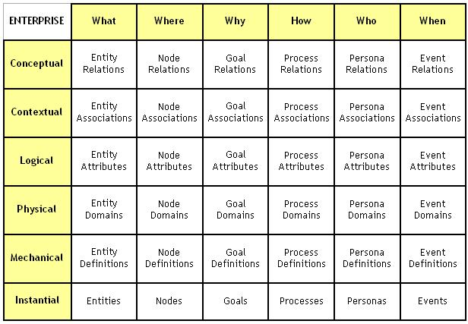
Zachman Framework – Outputs

Slide 34
References
http://pubs.opengroup.org/architecture/togaf8-doc/arch/toc.html
https://www.orbussoftware.com/enterprise-architecture/togaf/what-is-the-adm/
https://www.zachman.com/

